Slide 1

Creating an Uzbek Dependency Treebank via Mapping and Annotating
Matlatipov Sanatbek
26 August 2024

Slide 2

Contents
Introduction
Uzbek Language(I-II)
Review(Uzbek NLP)
Purpose
Pipeline
Evaluations & Conclusion

Slide 3
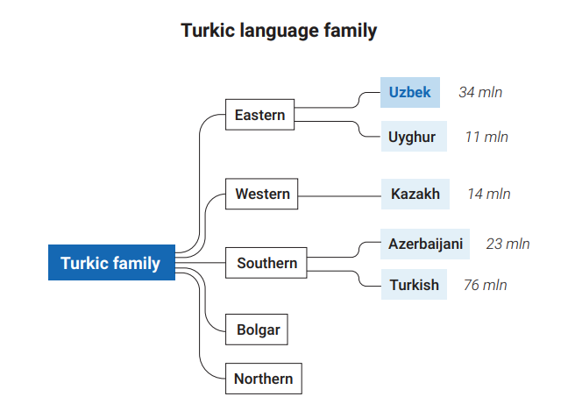
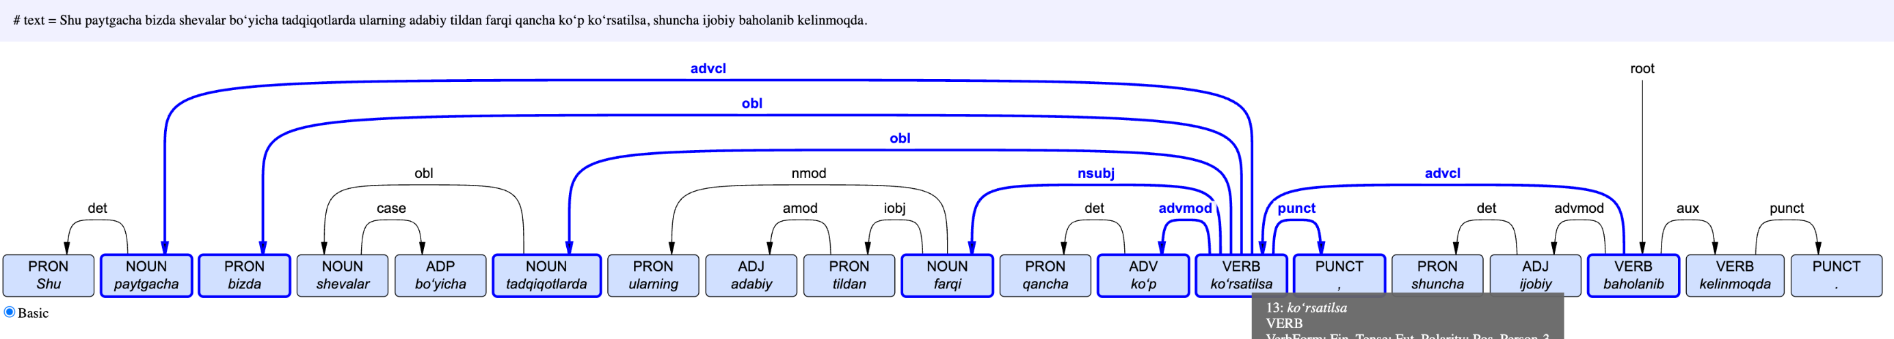
Introduction Uzbek Language(I-III) Review(Uzbek NLP) Purpose Shared tasks & Annotation Evaluation & Conclusion
INTRODUCTION
From Uyghur to Uzbek Mapping
Uzbek and Uyghur are sister languages in the Karluk (Southeastern) branch of Turkic—descended from Chagatai—so they share agglutinative morphology, SOV word order, and much core vocabulary. Their long, intertwined Central Asian history reinforced these similarities, despite differences like Uzbek’s reduced vowel harmony and differing scripts. (https://en.wikipedia.org/wiki/Uzbek_language )
* The picture is taken from here

Slide 4
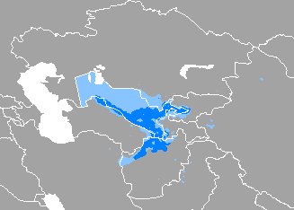
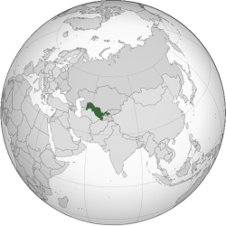
Introduction Uzbek Language(I-III) Review(Uzbek NLP) Purpose Shared tasks & Annotation Evaluation & Conclusion
Uzbek Language I
Not enough work done
Low-Resource(NLP resources) ≠ low density
Our Language is Uzbek
Official language of Uzbekistan
Native to All CA Countries, Afghanistan, Russia, Xinjiang(China)
Spoken by 38 million (as of 2025)

Slide 5
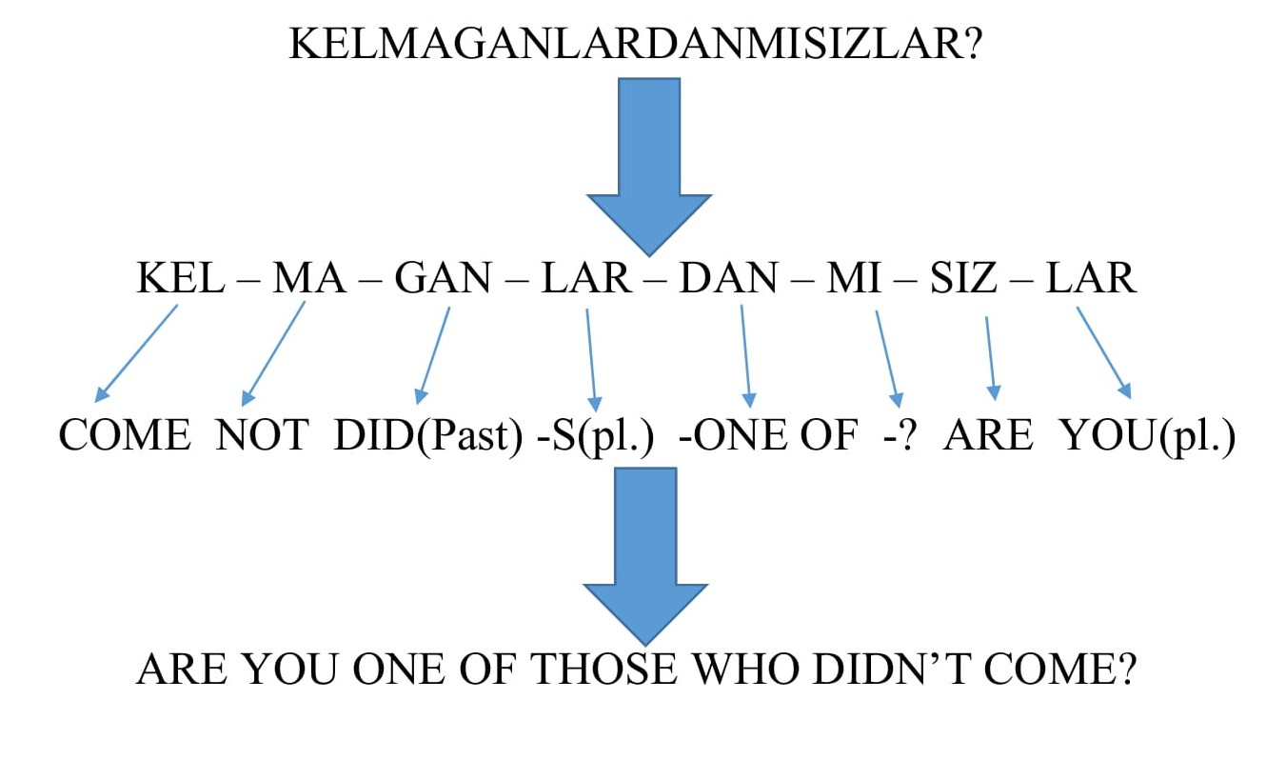
Introduction Uzbek Language(I-III) Review(Uzbek NLP) Purpose Shared tasks & Annotation Evaluation & Conclusion
Uzbek Language II
Turkic Family
Null Subject
No Articles
No Gender
Subject-object-verb

Slide 6
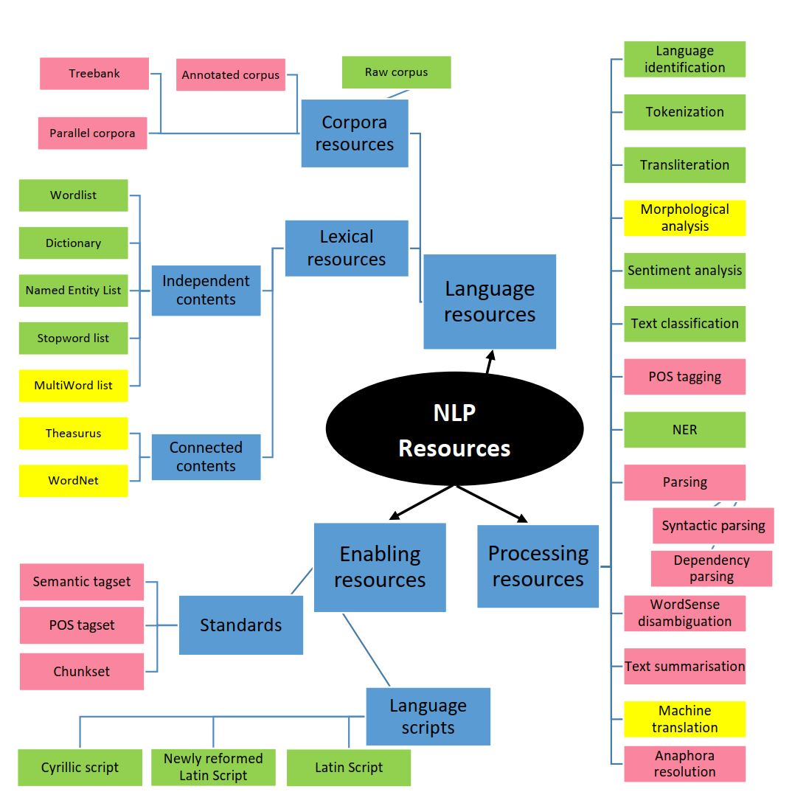
Introduction Uzbek Language(I-II) Review(Uzbek NLP) Purpose Shared tasks & Annotation Evaluation & Conclusion
Uzbek NLP progress
* Overall contributers: Sh.Nazirov, А. Po’latov, O’.Xamdamov, S.Qobilov(SamDU) va M.Musaevlar
* Dictionaries, synsets, and stopwords. The book of Uzbek dictionary words in both Latin and Cyrillic scripts [Tog’ayev et al.(1999)], WordNet type synsets data [Agostini et al.(2021)], and WordNet type thesaurus datasets [Aripov(2018)]. Automatic detection of stopwords in Uzbek has been proposed by Madatov et. al. [Madatov et al.(2022)].
* Language identification, and Tokenization - (both sentence-level and word-level) are general tasks that, once done, can easily include the majority of languages at once. Moreover, [Bakaev, Ilkhom. (2021). Tokenization task]
* Written scripts and machine transliteration - [Mansurov and Mansurov(2021a)] propose a tool based on decision tree to transliterate between Cyrillic and Latin scripts. Recent work from [Salaev et al.(2022a), Kuriyozov, and G ́omez-Rodr ́ıguez] worked on machine transliteration.
* Morphological Analysis(MA). The first works on Uzbek morphological analyzers was done using the rule-based method[Matlatipov and Vetulani(2009)]. The Apertium-Uzb monolingual package also has the biggest available annotated wordlist for Uzbek. [Nilufar Abdurakhmonova & Tuliyev have paper on FST based MA.]
* Text Classification. [Ignatev N.A., Tuliyev U.] worked on creating patterns from NLWords based on text(document).
* Machine Translation: [Aripov, Khakimov M., Matlatipov S.,, Abdurakhmonova N., Allaberdiyev B., Altynbek Sharipbay]
* Sentiment Analysis: [Aripov Mersaod, Matlatipov Sanatbek, Kuriyozov Elmurod, Rabbimov Ilyos, Kobilov Sami]

Slide 7
Introduction Uzbek Language(I-III) Review(Uzbek NLP) Purpose & steps Shared tasks & Annotation Evaluation & Conclusion
Purpose
The pipeline’s purpose is to bootstrap a high-quality, UD-compliant Uzbek dependency treebank by systematically transferring, normalizing, and validating annotations from the closely related Uyghur UD corpus. It minimizes manual effort and error through staged, auditable transformations (transliteration, rule/lexicon/morph mapping, frequency-targeted fixes) culminating in expert review—producing a reproducible resource for training and evaluating Uzbek NLP tools.

Slide 8
Introduction Uzbek Language(I-III) Review(Uzbek NLP) Purpose & steps Pipeline Evaluation & Conclusion
Pipeline
Goal: Produce a high-quality, UD-compliant Uzbek dependency treebank by systematically mapping the Uyghur UD corpus and finalizing with expert review.
Inputs: Uyghur UD train/dev/test CoNLL-U; a 670-sentence Uzbek sample set; Uy→Uz dictionaries (APK-extracted + English-pivot merge + sample-derived); suffix lists; UD guidelines.
Environment & tooling: Python 3.11 venv; modular scripts (merging, transliteration, orthographic rules, dictionary mapping, coverage and distance reporting, morphology split/merge, pseudo-dictionary, hitparade).
Tracking & metrics: Extra converted column for each token; per-step Conversion Coverage (% 1s) and Mean Average Levenshtein Distance (% similarity to Uzbek sample).
Flow (phases):
Preparation & tracking (merge splits; add provenance flags; extract 100-sent sample).
Form normalization (transliteration; orthographic mappings).
Lexical substitution (large Uy→Uz dictionary; sample-derived dictionary).
Morphology handling (lemma/suffix split; recomposition).
Heuristic expansion (pseudo-dictionary from suffix cues; frequency “hitparade” micro-dict).
Human pass (multi-annotator correction under UD guidelines).
Outputs: Step-tagged mapped files (e.g., uz_udt-mapped-06.txt, -07.txt, -08.txt), vetted pseudo dictionaries, coverage/distances per step, and the finalized 100% Uzbek treebank.
Reproducibility: Deterministic steps first, auditable artifacts at each stage, and clear provenance from raw Uyghur to final Uzbek UD.

Slide 9
Introduction Uzbek Language(I-III) Review(Uzbek NLP) Purpose Mapping pipeline Evaluation & Conclusion
Mapping pipeline
Python code: UDMapper.py: -> The main code for mapping. Performs all the necessary steps through this code, hence continuously expanding as more steps are added.
Step-01: Merging the train/dev/test .conllu files in the Uyghur treebank into one file;
Also, to track the mapping changes in the next steps, we add an extra column at the end of each line called ‘converted’ with boolean values:
Initially set to 0, then when the word is completely converted to Uzbek, we set it to 1;
Python code: RandomSentencer.py:
Runs once, only takes random 100 sentences from the merged .conllu treebank for the statistical report, extracts the sample.conllu file for translating into uzbek for later checks.
Python code: ConversionCoverage.py:
Looks through the last column of the .conllu file and counts how many 0 and 1 values are there, based on that, it calculates the % of the conversion;

Slide 10
Introduction Uzbek Language(I-III) Review(Uzbek NLP) Purpose Mapping pipeline Evaluation & Conclusion
Mapping pipeline
Step-02: Transliterating all the Arabic text in the resulting treebank into Latin;
Python code: UyghurTransliterator.py:
Transliterates Uyghur Arabic into Latin using character mapping;
Python code: Checker.py:
An optional helper code. Performs a quick check on the resulting transliterated treebank file to see if there are any Arabic or unwanted characters left without transliteration;
Creates the dictionary of the words in the .conllu file;
Step-03: Replacing some characters and/or set of characters with their Uzbek alternatives;
Python code: UyghurMapper.py:
Introduces set of rules to map some characters and replaces them for Step 03;
Python code: DistanceComparison.py:
A python class that reads the sample.conllu file (100 sentences in Uzbek) and compares it to the resulting conllu treebank of each step to how much (in %) closer is the result to the actual Uzbek;

Slide 11
Introduction Uzbek Language(I-III) Review(Uzbek NLP) Purpose Mapping pipeline Evaluation & Conclusion
Mapping pipeline
Step-04: Replacing tokens with their translations using a dictionary extracted from database:
Extracting Uyghur-English dictionary from internet resources;
I already have the Uzbek-English dictionary;
Merging two dictionaries and extracting the Uyghur-English-Uzbek dictionary;
We have extracted an uyghur-uzbek dictionary from a database, and performed several steps to make it one-to-one final version:
Uy-uz-final.txt
Step-05: Replacing tokens with their translations using a dictionary extracted from the random sentence coverage step:
We have extracted another uyghur-uzbek dictionary from a sample.connlu file:
Uy-uz-sample-uniq.txt

Slide 12
Introduction Uzbek Language(I-III) Review(Uzbek NLP) Purpose Mapping pipeline Evaluation & Conclusion
Mapping pipeline
Step-06: Replacing words by splitting them into lemma and suffix and finding their translations to merge;
Step-07: Creating a Pseudo-mapping dictionary:
Going through not-converted tokens (that their lemmas are missing);
Trying to find out its stem and suffix by checking if it ends with one of the common suffixes;
If so, check the stem part and if it also exists in the dictionary, this is a possible match;
Since this is a risky assumption to directly play with the production level treebank, one has to write the results into a dictionary format file, and manually confirm, fixing/removing the erroneous ones:
pseudo-dictionary.txt
Step-08: Creating a list of not converted words and mapping them using a manually created dictionary:
uy-uz-hitparade.txt
Step-09:Word-ending-based mapping: replacing the common (only) suffixes with their Uzbek alternatives:
Since this is a risky action, we write the results to another pseudo-dictionary file for manual inspection:
pseudo-suffix-dictionary.txt
Step-10 : Word-by-word translation-2: Replacing stems with their Uzbek alternatives using aligned word embeddings:
Take Uzbek word-embeddings (I have it);
Take or create Uyghur Word embeddings;
Align two embeddings (MUSE, MEEMI) using a small dictionary as a pivot;
For every word in Uyghur:
Choose the list of 15-20 words around the chosen words coordinates, and pick the closest word based on the Levenshtein distance;
Replace the source word with target one;

Slide 13
Introduction Uzbek Language(I-III) Review(Uzbek NLP) Purpose Mapping pipeline Outputs of the steps
Output of the steps
Step-1: Merge Uyghur trin/dev/test conllu files into one:
Mean Average Levenshtein Distance (in percentage): 11.90%
Conversion Coverage:
Total Count of tokens: 40236
Count of 0: 40236
Count of 1: 0
Conversion Percentage: 0.00%
Step-2: Transliterate the merged file from Uyghur arabic into Uyghur latin:
Mean Average Levenshtein Distance (in percentage): 73.17%
Conversion Coverage:
Total Count of tokens: 40236
Count of 0: 32429
Count of 1: 7807
Conversion Percentage: 19.40%

Slide 14
Introduction Uzbek Language(I-III) Review(Uzbek NLP) Purpose Mapping pipeline Outputs of the steps
Output of the steps
Step-3: Run some statistics on the resulting transliterated file to see what mappings can be done to make words closer to Uzbek:
Total words affected: 15674
Mean Average Levenshtein Distance (in percentage): 79.80%
Conversion Coverage:
Total Count of tokens: 40236
Count of 0: 32429
Count of 1: 7807
Conversion Percentage: 19.40%
Step-4: Convert words into their uzbek translation using a big dictionary obtained from a database:
Total words read from dictionary: 3855
Total number of words changed: 8766
Mean Average Levenshtein Distance (in percentage): 83.04%
Conversion Coverage:
Total Count of tokens: 40236
Count of 0: 23663
Count of 1: 16573
Conversion Percentage: 41.19%

Slide 15
Introduction Uzbek Language(I-III) Review(Uzbek NLP) Purpose Mapping pipeline Outputs of the steps
Output of the steps
Step-5: Convert words into their uzbek translation using a big dictionary obtained from a sample.conllu file:
Total words read from dictionary: 747
Total number of words changed: 5231
Mean Average Levenshtein Distance (in percentage): 98.63%
Conversion Coverage:
Total Count of tokens: 40236
Count of 0: 18432
Count of 1: 21804
Conversion Percentage: 54.19%
Step-6: Going through not converted tokens and splitting to stem and suffix, then converting each to merge later:
Total words read from dictionary: 4441
Total words read from dictionary: 142
Total number of lines changed: 2909
Created a text collection: uz_udt-mapped-06.txt
Mean Average Levenshtein Distance (in percentage): 98.63%
Conversion Coverage:
Total Count of tokens: 40236
Count of 0: 15523
Count of 1: 24713
Conversion Percentage: 61.42%

Slide 16
Introduction Uzbek Language(I-III) Review(Uzbek NLP) Purpose Mapping pipeline Outputs of the steps
Output of the steps
Step-07: Creating a Pseudo-mapping dictionary and mapping by that dictionary
Total words read from dictionary: 741
Total number of words changed: 1592
Created a text collection: uz_udt-mapped-07.txt
Mean Average Levenshtein Distance (in percentage): 98.63%
Conversion Coverage:
Total Count of tokens: 40236
Count of 0: 13931
Count of 1: 26305
Conversion Percentage: 65.38%
STEP-08: Creating a hitparade of not converted words and mapping them using a manually created dictionary:
Total words read from dictionary: 973
Total number of words changed: 5628
Created a text collection: uz_udt-mapped-08.txt
Mean Average Levenshtein Distance (in percentage): 98.63%
Conversion Coverage:
Total Count of tokens: 40236
Count of 0: 8303
Count of 1: 31933
Conversion Percentage: 79.36%

Slide 17
Introduction Uzbek Language(I-III) Review(Uzbek NLP) Purpose Mapping pipeline Outputs of the steps
Output of the steps
STEP-9: Manually correcting the entire treebank using help form Uzbek linguists and LLM judgement:
FINALLY: The 100% mapped new Uzbek treebank is ready.

Slide 18
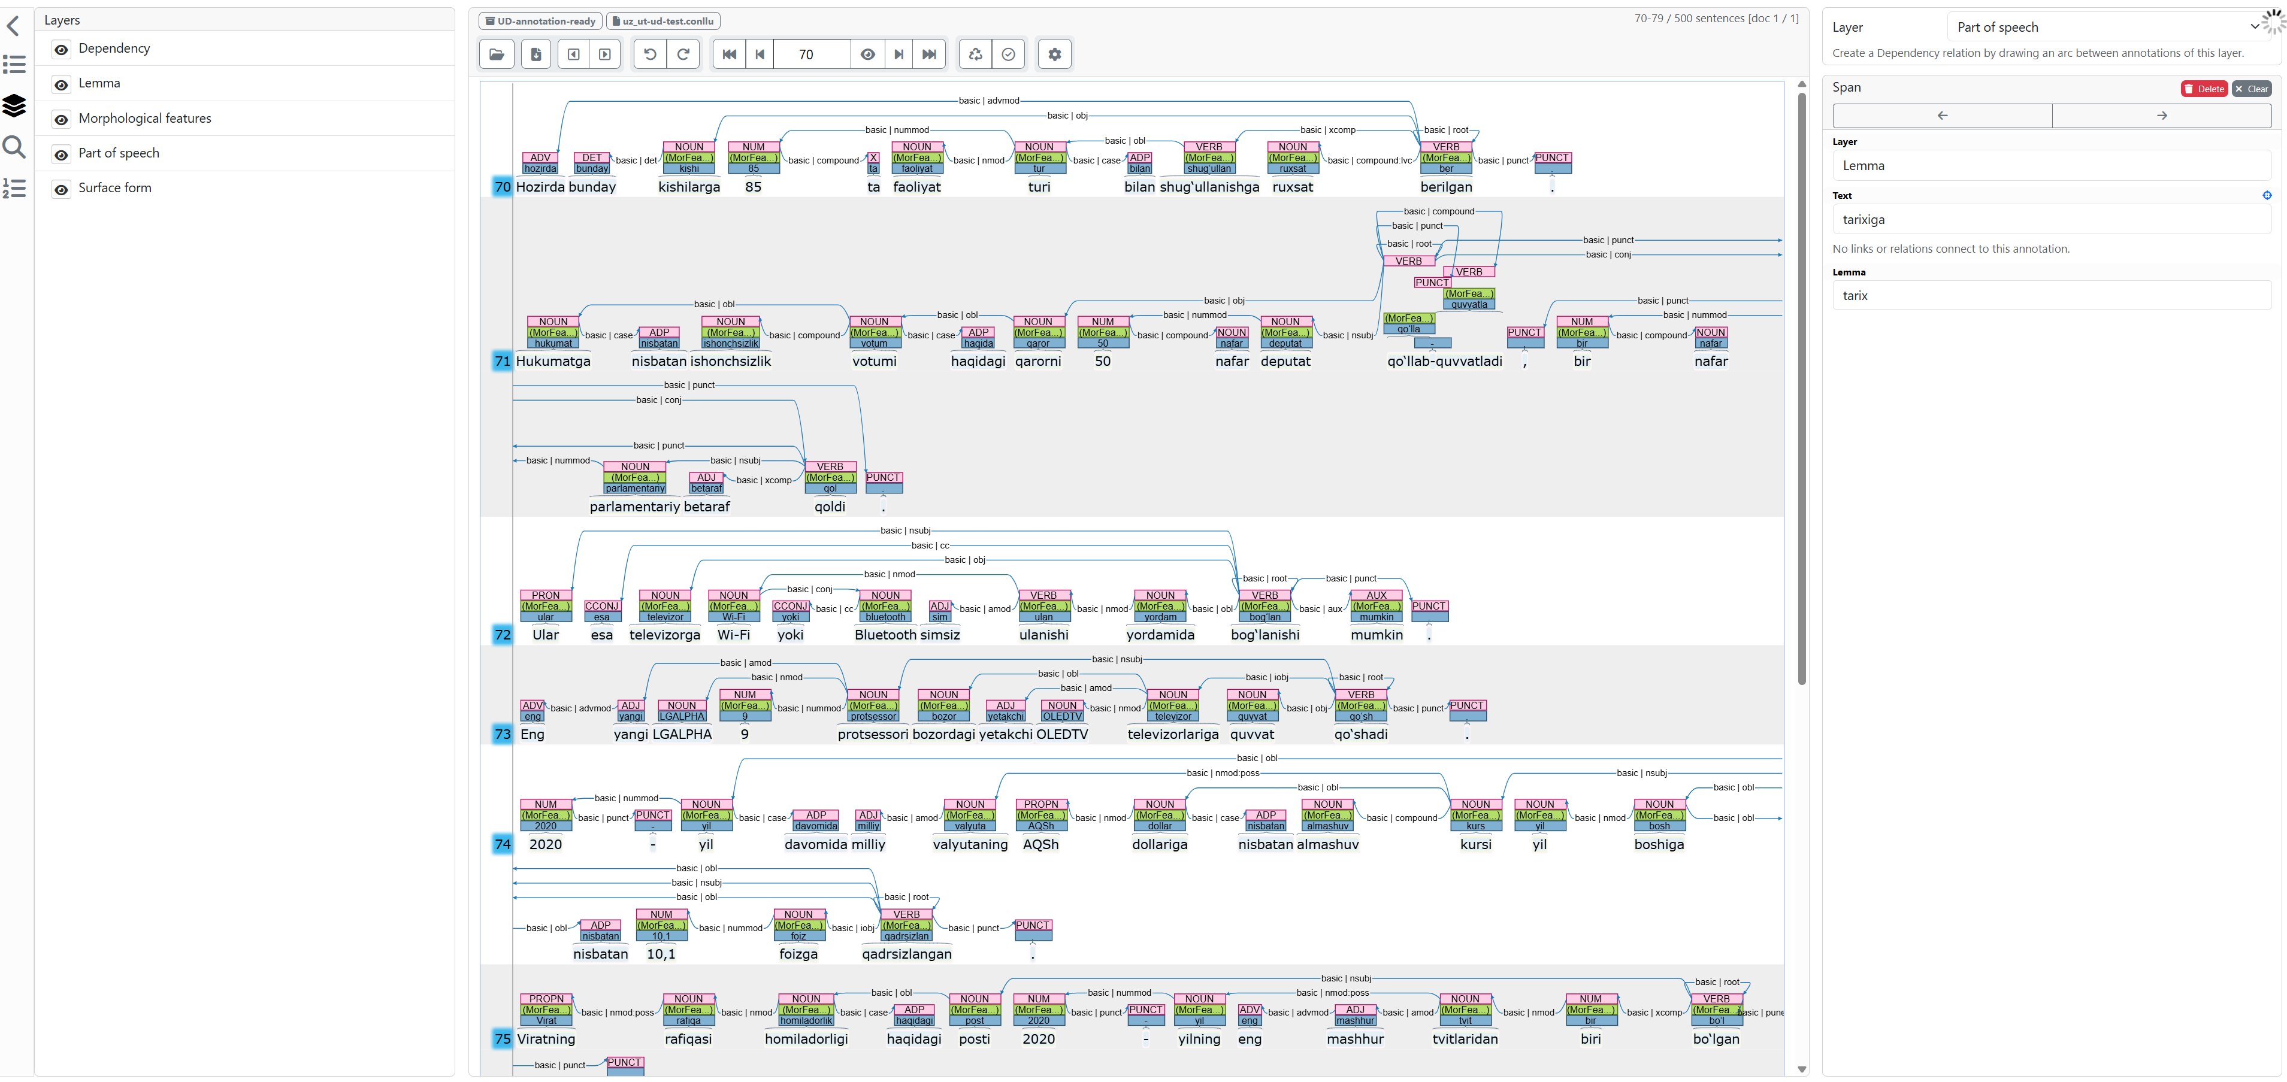
Introduction Uzbek Language(I-III) Review(Uzbek NLP) Purpose Annotation Evaluation & Conclusion
Annotation

Slide 19
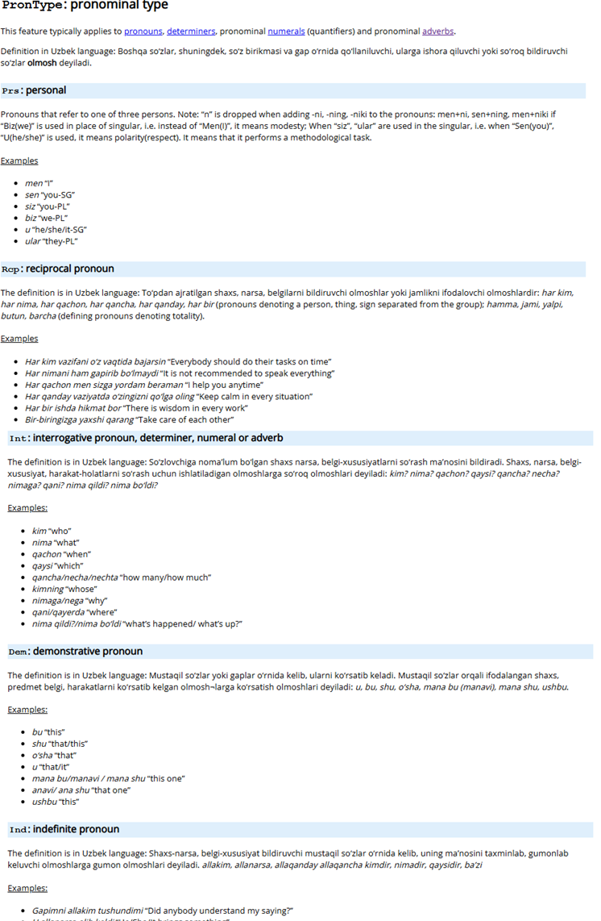
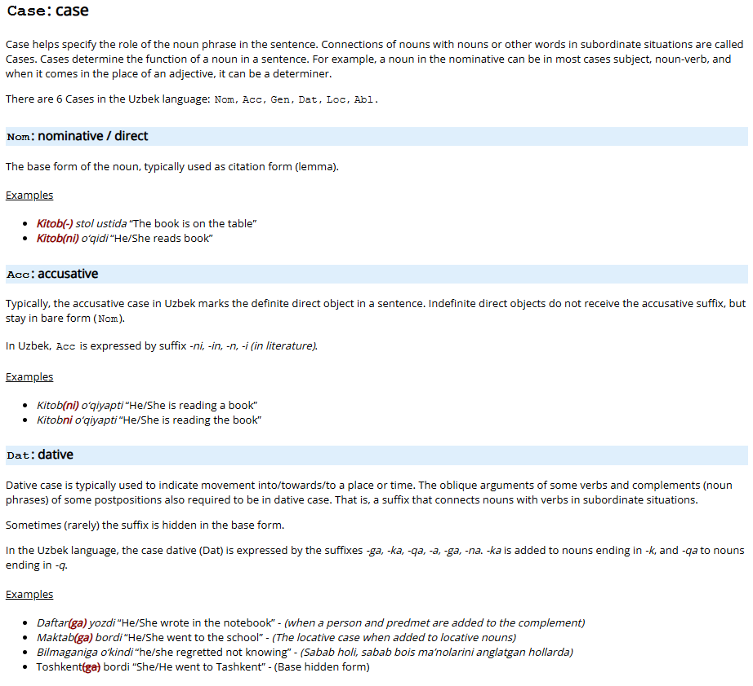
YO‘RIQNOMAGA MISOL

Slide 20

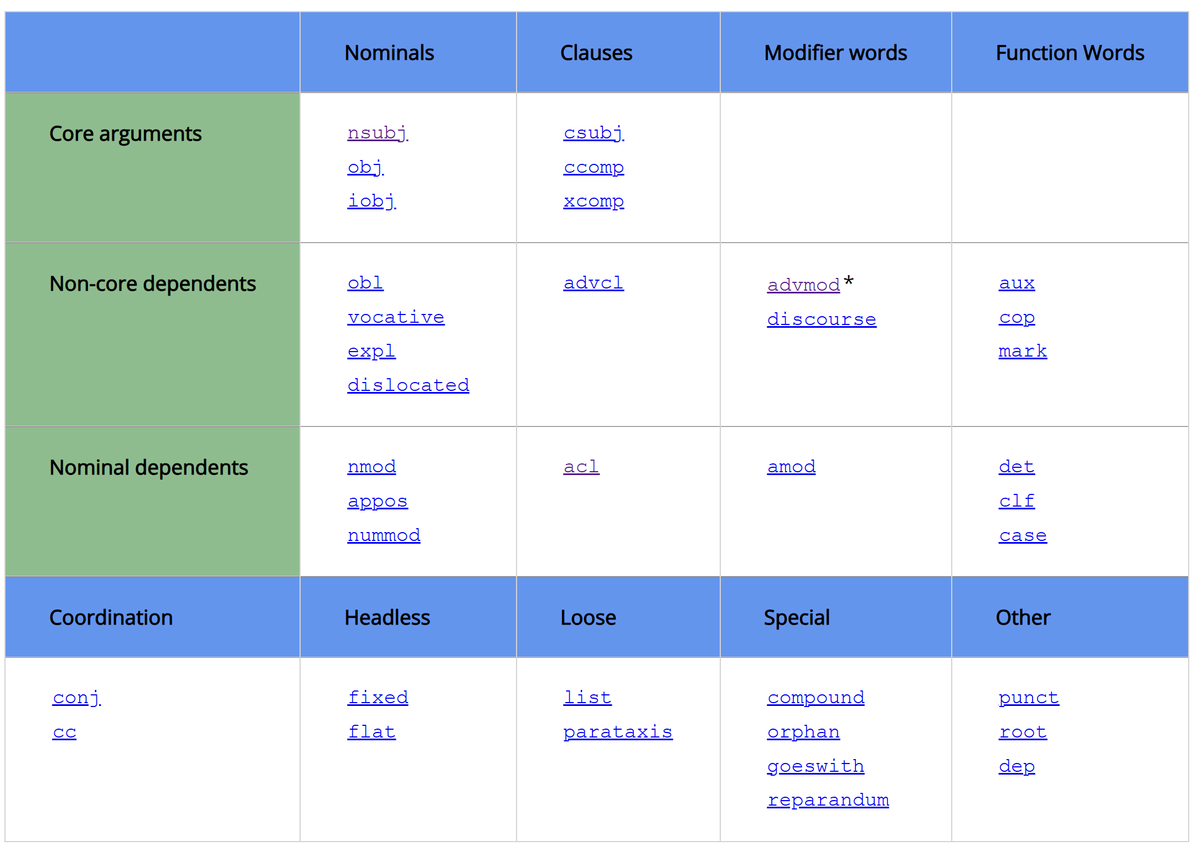
II BOB. O‘ZBEK TILINING IYERARXIK TAHLILI KORPUSINI YARATISH METODLARI VA AMALIY-TEXNOLOGIK JIHATLARI
5
IYERARXIK BOG‘LIQLIKLARNI ANIQLASH
3
4

Slide 21
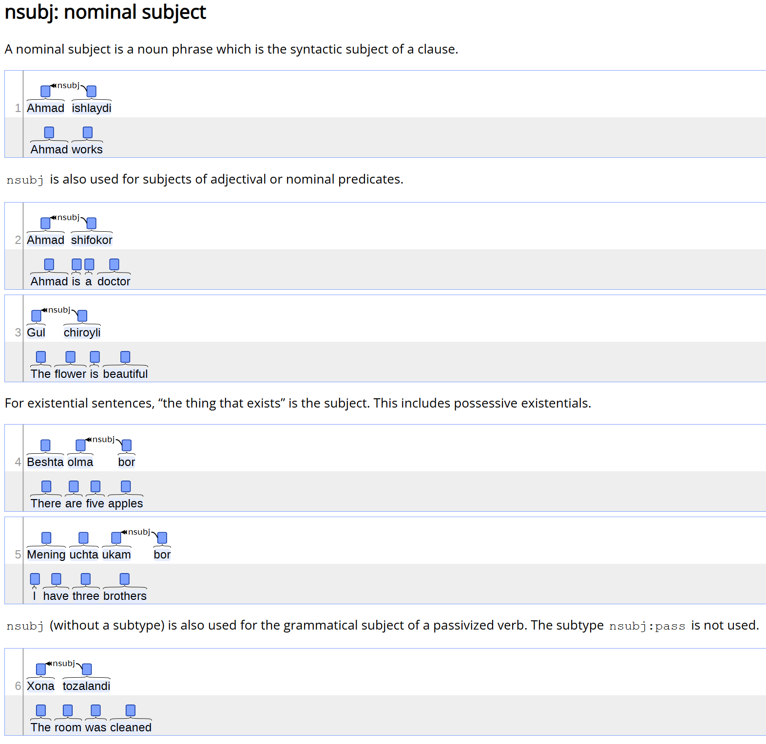
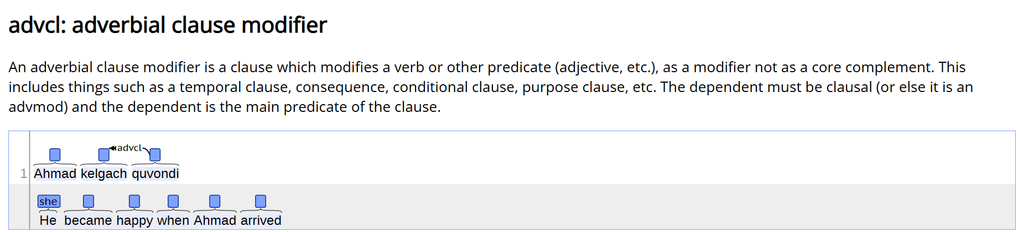
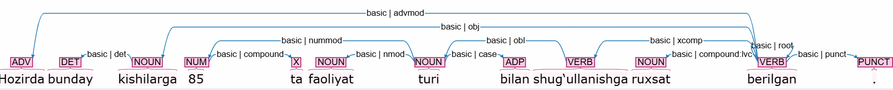

Slide 22
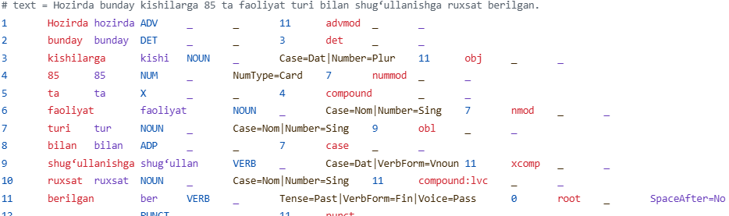
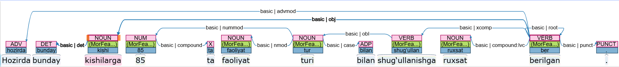
6
Sample from purely annotated sentences
3
4
https://github.com/apertium/apertium-uzb

Slide 23
Introduction Uzbek Language(I-III) Review(Uzbek NLP) Purpose Shared tasks & Annotation Future Work
Future work
Expanding the dataset using a RAG pipeline.
Finishing all documentations and annotation guideline which available in English, currently it is available in Uzbek language.
Expanding the team of expert linguists to annotate pure treebank for Uzbek language

Slide 24
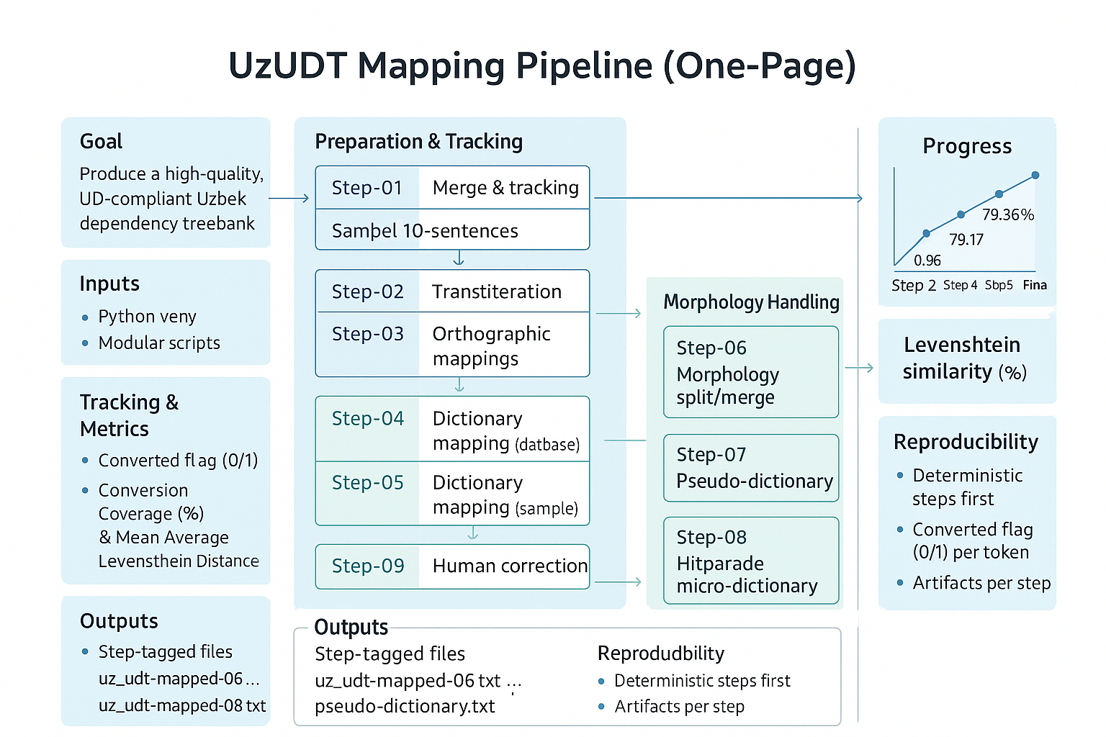
Introduction Uzbek Language(I-III) Review(Uzbek NLP) Purpose & steps Shared tasks & Annotation Evaluation & Conclusion
Pipeline(AI generated)

Slide 25
THANK YOU VERY MUCH FOR YOUR ATTENTION
E’tiboringiz uchun RAHMAT!

